Slide 1
Getting Started with Pandas
Introduction to Pandas
Creating a Series
Using a Series
Creating a DataFrame
Using a DataFrame

Slide 2
Section 1: Introduction to Pandas
What is Pandas?
Reminder about data science libraries
Primary Pandas data types

Slide 3
What is Pandas?
Pandas is the primary Python module for data science
Builds on top of the capabilities of NumPy
What does Pandas add to NumPy arrays?
Separate data types per column
Labelled columns (not just column number)
Specific index type for rows (not just row number)
Pandas also provides extra data processing functionality
E.g. join datasets (like in SQL)
E.g. pivot tables (like in Excel)
E.g. string functions and regular expressions

Slide 4
Reminder about Data Science Libraries
If you're using a standalone Python distribution, you must download the data science libraries using pip:
Note: if you're using Anaconda, the data science libraries are already downloaded for you
In your Anaconda installation folder, see Lib/site-packages
pip install numpy
pip install openpyxl
pip install xlrd
pip install matplotlib
pip install pandas
pip install seaborn
pip install cython
pip install scikit-learn

Slide 5
Primary Pandas Data Types
Series
Stores a 1D array of data, like a NumPy 1D ndarray
Elements are accessed by index
DataFrame
Stores a 2D array of data, like a NumPy 2D ndarray
Elements are accessed by column name and index
Index
Series and DataFrame objects have a specific index
The index is like a 1D array of row-specifiers
Can be any type (e.g. integer, date/time, string, etc.)

Slide 6
Section 2: Creating a Series
Creating a simple Series object
Creating a Series with an explicit index
Creating a Series from a dictionary

Slide 7
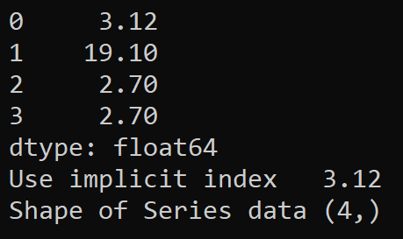
Creating a Simple Series Object
You can create a Series from a simple list of items
Pandas automatically creates an integral index (0, 1, 2, etc…)
You access items by integral index
(Note: We won't show the import pandas statement in the rest of the code samples in this chapter)
# Import the Pandas module.
import pandas as pd
# Create a Series with values and implicit index.
s = pd.Series([3.12, 19.1, 2.7, 2.7])
# Use the Series.
print(s)
print('Use implicit index ', s[0])
print('Shape of Series data', s.shape)
Ex01-SeriesSimple.py

Slide 8
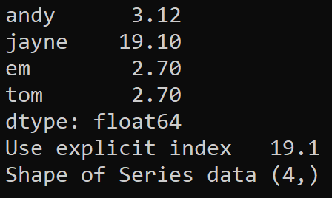
Creating a Series with an Explicit Index
You can specify an explicit index for a Series object
This is different to NumPy ndarray, where index is just a number
You access items by index
# Create a Series with values and implicit index.
s = pd.Series([3.12, 19.1, 2.7, 2.7],
index=['andy', 'jayne', 'em', 'tom'])
# Use the Series.
print(s)
print('Use explicit index ', s['jayne'])
print('Shape of Series data', s.shape)
Ex02-SeriesExplicitIndex.py

Slide 9
Creating a Series from a Dictionary
You can create a Series from a Python dictionary
Specify index/value pairs
You access items by index
# Create a Series from a Python dictionary.
s = pd.Series({
'andy': 3.12,
'jayne': 19.1,
'em': 2.7,
'tom': 2.7
})
# Use the Series.
print(s)
print('Use explicit index ', s['jayne'])
print('Shape of Series data', s.shape)
Ex03-SeriesFromDictionary.py

Slide 10
Section 3: Using a Series
Overview
Series with a non-numeric index
Series with a numeric index

Slide 11
Overview
There are two ways to index into a Series
Using an explicit index (like a key in a dictionary)
Using an implicit index (like a row number in an array)
We'll also see how to disambiguate the meaning of [i] if the Series has numeric keys
Is i an explicit index or a row number...?

Slide 12
Series with a Non-Numeric Index
If you have a Series with a non-numeric index:
You can access an item via an explicit index, e.g. ['E101']
You can also access an item via an implicit index, e.g. [1]
# Create a Series where the index is non-numeric.
data = pd.Series(['John', 'Mary', 'Emma', 'Alex', 'Jeff'],
index=['E100', 'E101', 'E257', 'E118', 'E123'])
# You can access elements via explicit index.
print('\nIndexing via explicit index\n', data['E101'])
print('Slicing via explicit index\n', data['E101':'E118']) # Inclusive end.
# You can also access elements via implicit index, i.e. row number.
print('\nIndexing via implicit index\n', data[1])
print('Slicing via implicit index\n', data[1:3]) # Exclusive end.
Ex04-SeriesIndexingNonNumeric.py

Slide 13
Series with a Numeric Index
If you have a Series with a numeric index, be careful!
Indexing uses an explicit index, but slicing uses an implicit index!
For clarity:
Use .loc for an explicit index, .iloc for an implicit index
Ex05-SeriesIndexingNumeric.py
# Create a Series where the index is numeric.
data = pd.Series(['John', 'Mary', 'Emma', 'Alex', 'Jeff'],
index=[100, 101, 257, 118, 123])
# Using [] can be confusing!
print('\nIndexing uses explicit index\n', data[101])
print('But slicing uses implicit index\n', data[1:3]) # Exclusive.
# .loc always uses explicit index.
print('\n.loc indexing uses explicit index\n', data.loc[101])
print('.loc slicing uses explicit index\n', data.loc[101:118]) # Inclusive.
# .iloc always uses implicit index.
print('\n.iloc indexing uses implicit index\n', data.iloc[1])
print('.iloc slicing uses implicit index\n', data.iloc[1:3]) # Exclusive.

Slide 14
Section 4: Creating a DataFrame
Overview
Creating a simple DataFrame object
Accessing a DataFrame column
Creating a DataFrame with an explicit index
Creating a DataFrame from columnar data

Slide 15
Overview
In the previous section we showed how to create and use a Pandas Series object
A Pandas Series is like a NumPy 1D ndarray, with indexing
In this section, we'll show how to create and use a Pandas DataFrame object
A Pandas DataFrame is like to a NumPy 2D ndarray, with indexing
Each column has a name and data type
Each row is accessed by index

Slide 16
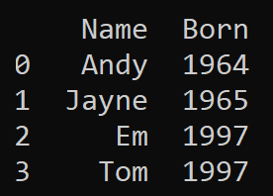
Creating a Simple DataFrame Object (1 of 2)
There are various ways to create a DataFrame…
This example creates a DataFrame from a collection of tuples
Each tuple here has 2 values (name, born)
The DataFrame has 2 columns, with the specified column names
The DataFrame has an implicit integral index
names = ['Andy', 'Jayne', 'Em', 'Tom']
born = [1964, 1965, 1997, 1997]
# Create a list of tuples. Each tuple is a (names, born) pair.
stats = list(zip(names,born))
# Create a DataFrame with specified data and column names.
df = pd.DataFrame(stats, columns=['Name', 'Born'])
print(df)
Ex06-DataFrameCreateFromTuples.py

Slide 17
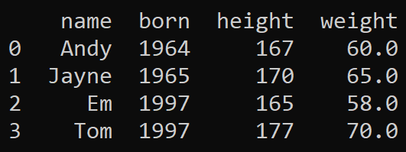
Creating a Simple DataFrame Object (2 of 2)
You can create a DataFrame from a list of dictionaries
Each dictionary represents one row in the DataFrame
stats = [
{'name': 'Andy', 'born': 1964, 'height': 167, 'weight': 60.0},
{'name': 'Jayne', 'born': 1965, 'height': 170, 'weight': 65.0},
{'name': 'Em', 'born': 1997, 'height': 165, 'weight': 58.0},
{'name': 'Tom', 'born': 1997, 'height': 177, 'weight': 70.0}
]
# Create a DataFrame with specified data and implicit column names.
df = pd.DataFrame(stats)
print(df)
Ex07-DataFrameFromDictionaries.py

Slide 18
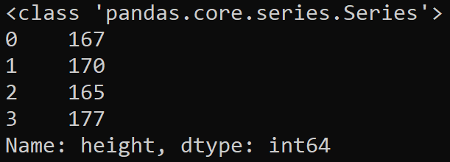
Accessing a DataFrame Column
You can access a column in a DataFrame by name
Returns a Series object
The Series object contains that column's values (plus indices)
stats = [
{'name': 'Andy', 'born': 1964, 'height': 167, 'weight': 60.0},
{'name': 'Jayne', 'born': 1965, 'height': 170, 'weight': 65.0},
{'name': 'Em', 'born': 1997, 'height': 165, 'weight': 58.0},
{'name': 'Tom', 'born': 1997, 'height': 177, 'weight': 70.0}
]
df = pd.DataFrame(stats)
# Access the 'height' column.
height_column = df['height']
print(type(height_column))
print(height_column)
Ex08-DataFrameAccessColumns.py

Slide 19
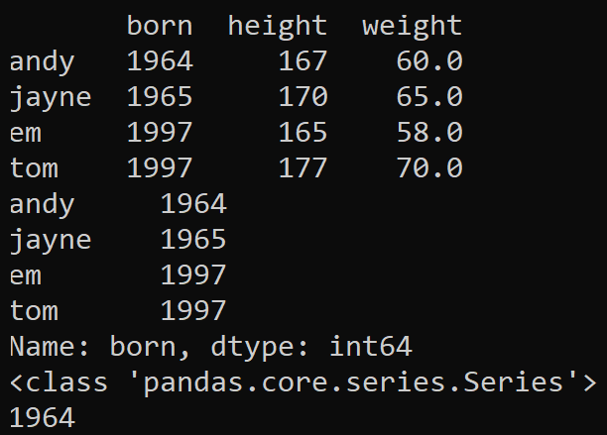
Creating a DataFrame with an Explicit Index
You can specify an explicit index for a DataFrame object
Very common, makes it easy to access rows in the DataFrame
stats = [
{'born': 1964, 'height': 167, 'weight': 60.0},
{'born': 1965, 'height': 170, 'weight': 65.0},
{'born': 1997, 'height': 165, 'weight': 58.0},
{'born': 1997, 'height': 177, 'weight': 70.0}
]
names = ['andy', 'jayne', 'em', 'tom']
# Create a DataFrame with specified data and index.
df = pd.DataFrame(data=stats, index=names)
# Use the DataFrame.
print(df)
print(df['born'])
print(type(df['born']))
print(df['born']['andy'])
Ex09-DataFrameExplicitIndex.py

Slide 20
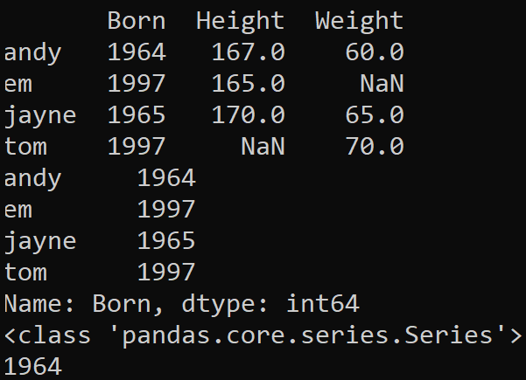
Creating a DataFrame from Columnar Data
You can create a DataFrame from columnar data
Create column as a Series (key is index, value is column data)
Pandas merges Series together (based on key)
Pandas fills any gaps with NaN
# Create a Series for each column.
bornSeries = pd.Series({'andy': 1964, 'jayne': 1965, 'em': 1997, 'tom': 1997})
heightSeries = pd.Series({'andy': 167, 'jayne': 170, 'em': 165})
weightSeries = pd.Series({'andy': 60.0, 'jayne': 65.0, 'tom': 70.0})
# Create a DataFrame from a bunch of Series objects.
df = pd.DataFrame({
'Born': bornSeries,
'Height': heightSeries,
'Weight': weightSeries
})
print(df)
print(df['Born'])
print(type(df['Born']))
print(df['Born']['andy'])
Ex10-DataFrameFromColumnarData.py

Slide 21
Section 5: Using a DataFrame
Working with DataFrame columns
Working with DataFrame rows
Working with DataFrame as a 2D array

Slide 22
Working with DataFrame Columns
A "simple index" into a DataFrame gets column(s)
bornSeries = pd.Series({'andy': 1964, 'jayne': 1965, 'em': 1997, 'tom': 1997})
heightSeries = pd.Series({'andy': 167, 'jayne': 170, 'em': 165, 'tom': 177})
weightSeries = pd.Series({'andy': 60.0, 'jayne': 65.0, 'em': 58.0, 'tom': 70.0})
df = pd.DataFrame({
'Born': bornSeries,
'Height': heightSeries,
'Weight': weightSeries
})
# Index into columns.
print('\nBorn\n', df['Born'])
print('\nHeight, Weight\n', df[['Height', 'Weight']])
print('\nBorn\n', df.Born)
# You can create new columns too...
df['BMI'] = df['Weight'] / ((df['Height']/100.0) ** 2)
print('\nBMI calculation\n', df['BMI'])
Ex11-DataFrameWorkingWithColumns.py

Slide 23
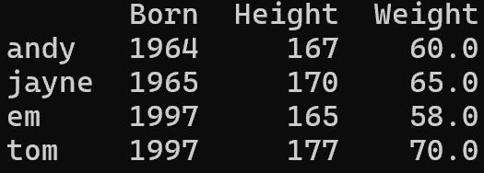
Working with DataFrame Rows
A "slice/fancy-index/mask" into a DataFrame gets rows
bornSeries = pd.Series({'andy': 1964, 'jayne': 1965, 'em': 1997, 'tom': 1997})
heightSeries = pd.Series({'andy': 167, 'jayne': 170, 'em': 165, 'tom': 177})
weightSeries = pd.Series({'andy': 60.0, 'jayne': 65.0, 'em': 58.0, 'tom': 70.0})
df = pd.DataFrame({
'Born': bornSeries,
'Height': heightSeries,
'Weight': weightSeries
})
# Slice rows.
print('\nandy and jayne\n', df['andy' : 'jayne'])
print('\nem onwards\n', df['em':])
print('\nup to em\n', df[:'em'])
print('\nup to em, step 2\n', df[:'em':2])
print('\nall, step 2\n', df[::2])
# Mask rows.
print('\n170cm or taller\n', df[df['Height'] >= 170])
print('\n60kg or lighter\n', df[df.Weight <= 60.0])
Ex12-DataFrameWorkingWithRows.py

Slide 24
Working with DataFrame as a 2D array
You can use .loc or .iloc to treat a DataFrame as a 2D array, and then use [row-indexer, col-indexer] syntax
bornSeries = pd.Series({'andy': 1964, 'jayne': 1965, 'em': 1997, 'tom': 1997})
heightSeries = pd.Series({'andy': 167, 'jayne': 170, 'em': 165, 'tom': 177})
weightSeries = pd.Series({'andy': 60.0, 'jayne': 65.0, 'em': 58.0, 'tom': 70.0})
df = pd.DataFrame({
'Born': bornSeries,
'Height': heightSeries,
'Weight': weightSeries
})
# Use .loc to treat like 2D array, [row-indexer-by-name, col-indexer-by-name].
print(df.loc['em':]) # Slice
print(df.loc['andy':'jayne', 'Height':'Weight']) # Slice
print(df.loc[['andy','tom'], ['Born', 'Height']]) # Fancy indexing
print(df.loc[df['Height'] >= 170, 'Height']) # Mask
# Use .iloc to treat like 2D array, [row-indexer-by-number, col-indexer-by-number].
print(df.iloc[2:]) # Slice
print(df.iloc[0:2, 1:3]) # Slice, exclusive end element.
print(df.iloc[[0,3], [0,1]]) # Fancy indexing
Ex13-DataFrameWorkingLikeArray.py

Slide 25
Summary
Introduction to Pandas
Creating a Series
Using a Series
Creating a DataFrame
Using a DataFrame

